Slide 1




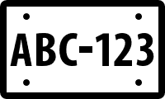
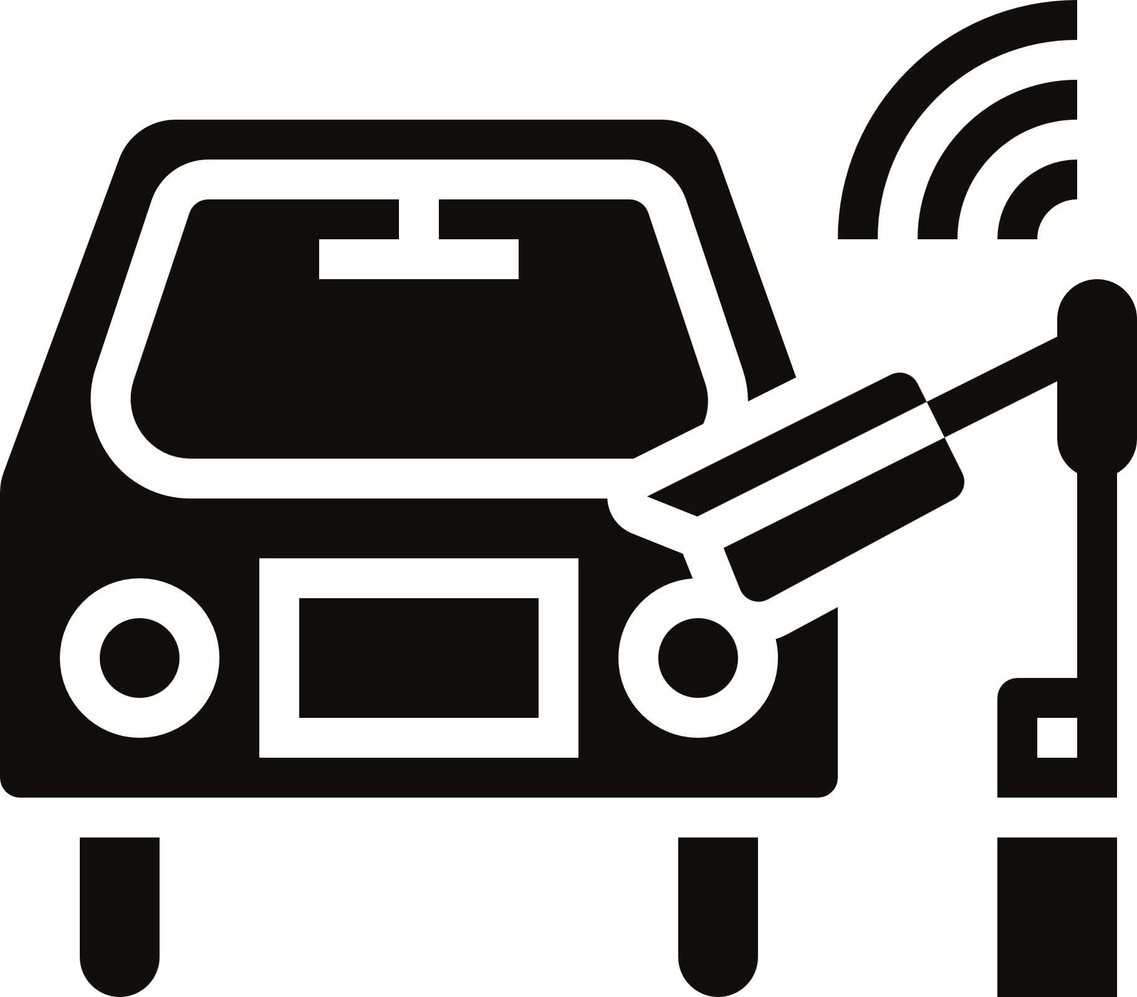

Project Demo Presentation
AUTOMATIC LICENSE PLATE RECOGNITION
TAN MIN HAN
21/12/2022

Slide 2

Agenda
Introduction to Parkify
02
Architecture Diagram
03
Project Timeline
04
Goals & Challenges
05
How it works? Demo
06
Future Development
07
01

Slide 3


Big change we are seeing in the world today
Automatic License Plate Recognition
It is a system consisting of cameras that are capable to detect and read license plates, converting the information on the license plate into a digital format and sending the result to processing systems, like an access control system, a tolling system or a parking management system.
02

Slide 4
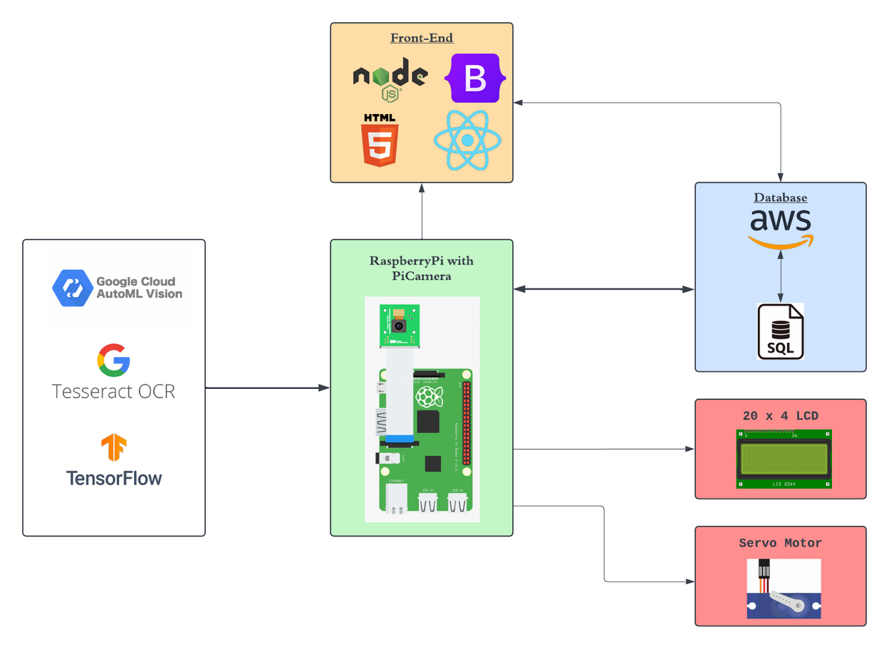
Architecture Diagram
Training Data with Google Cloud
Considering database should be MongoDB or MySQL
Front-End
03

Slide 5
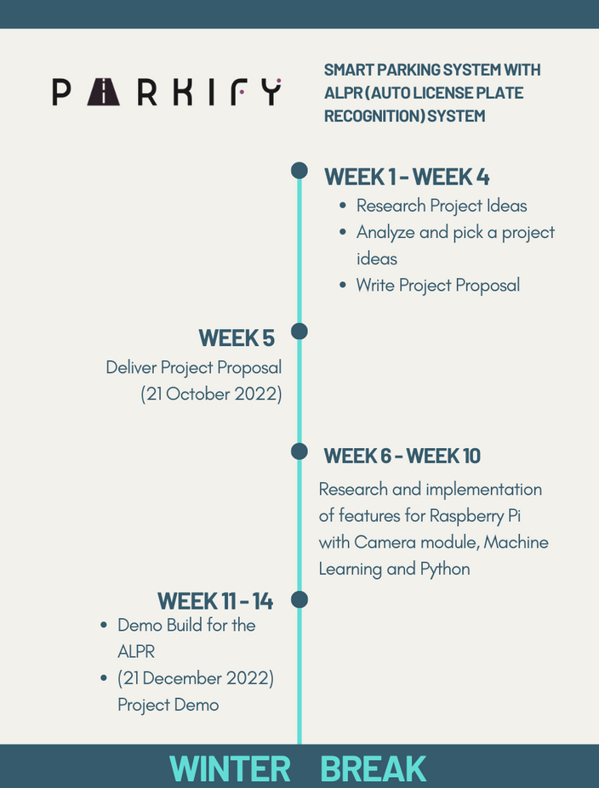

Project Timeline
Progression (Before Winter Break)
Achieved the project demo build before the timeline before winter break.
04

Slide 6


Project Timeline
After Winter Break
Planned to set up the database and do more research about MongoDB & SQL to decide which database should I use for my project.
04

Slide 7







GOALS & CHALLENGES
“Only those who dare to fail greatly can ever achieve greatly.” – Robert F. Kennedy
MACHINE LEARNING
Object Detection & Character Recognition
RaspberryPI
Getting a depth knowledge about how Machine Learning works and how can we apply ML to our life or world.
Python Language
Setting up and configuring RaspberryPi
Implement with camera for image capture
Tensorflow
Tesseract OCR, EasyOCR, GoogleOCR
How we train model with machine learning to detect certain object
How we extract the character from an image or a video
Time Management
Fear of Failure
Database
How we manage time to achieve the project timeline that we planned ahead. The learning curve of a new language / module time to achieve our progression.
Fear that project will not be complete on time or by the deadline.
Problems and bugs with code and new languages
The challenges and obstacles that could lead us and ourselves fail but we can learn
Setting up a database for the project that could monitor the system application
Lack of experience with database
Database with image or character
05

Slide 8
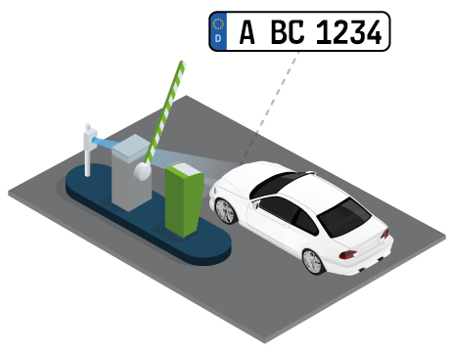
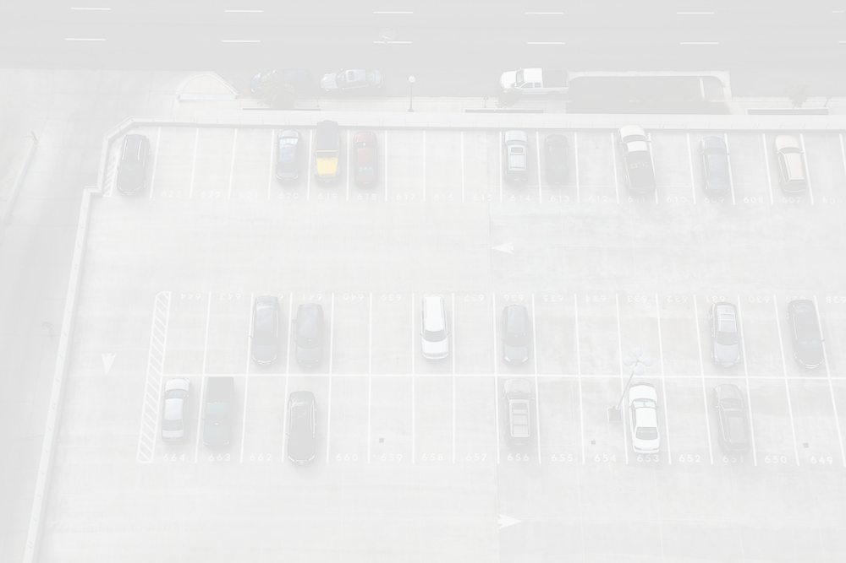

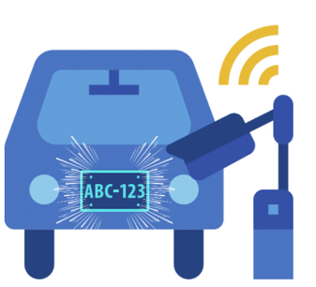

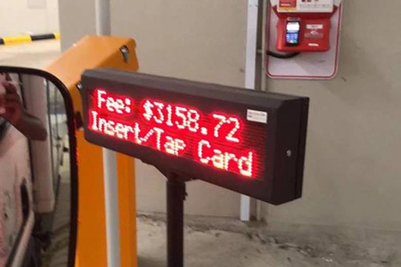


Camera captures the license plate of a car when it enters the parking lot.
License plate information is sent to a Raspberry Pi equipped with Google Cloud Vision API for character recognition.
Raspberry Pi sends the recognized license plate information to a MongoDB database for storage and further processing.
Users can access the database via a web app or mobile app to view the parking records and fees.
06

Slide 9


Feel free to ask any questions!
07

